Slide 1
Standards for essential and vegetable oils – trade facilitator or barrier?
Karen Swanepoel SA Essential Oil Producers Association 15 September 2023

Slide 2
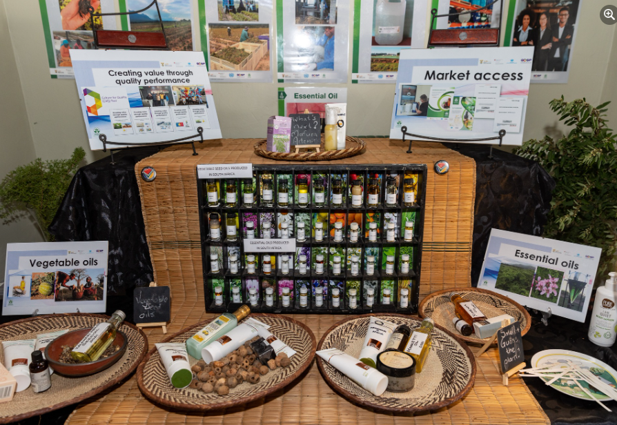
The importance of ISO standards
for essential and vegetable oils
In South Africa
African Biotrade Festival
KM Swanepoel
2023
.

Slide 3
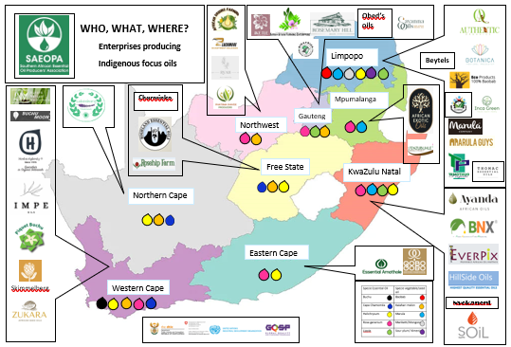
Confirming the need of standards The Department of Trade, Industry and Competition of South Africa (the dtic), the United Nations Industrial Development Organization (UNIDO), and the Swiss State Secretariat for Economic Affairs SECO meeting 24th May 2023

Slide 5
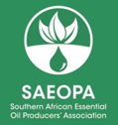
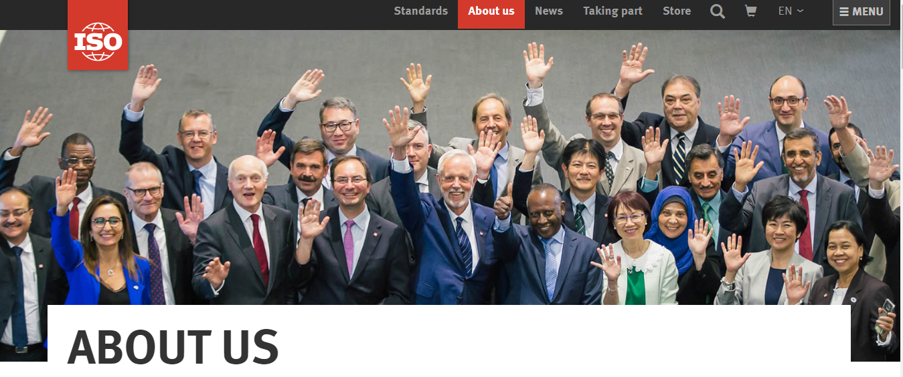
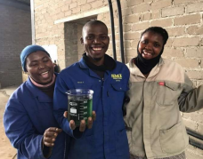
Why, which standards?
Standards of aromatic and medicinal plants are not very well published and applied in developing countries.
Prior to 2018, South Africa have published only two ISO standards published for medicinal plants namely Aloe ferox and Moringa oleifera.
This situation led to exploitation by the buyers of oils from less developing countries.
The recent increase in demand is observed but the standards are not keeping up with the new development in the industry.
In this presentation, the procedure for the writing of standards and the status of ISO standards as submitted to SABS is explained for Pelargonium var rose (Rose geranium), Adansonia digitata (Baobab), Sclerocarya birrea (Marula), and Lippia javanica.

Slide 6
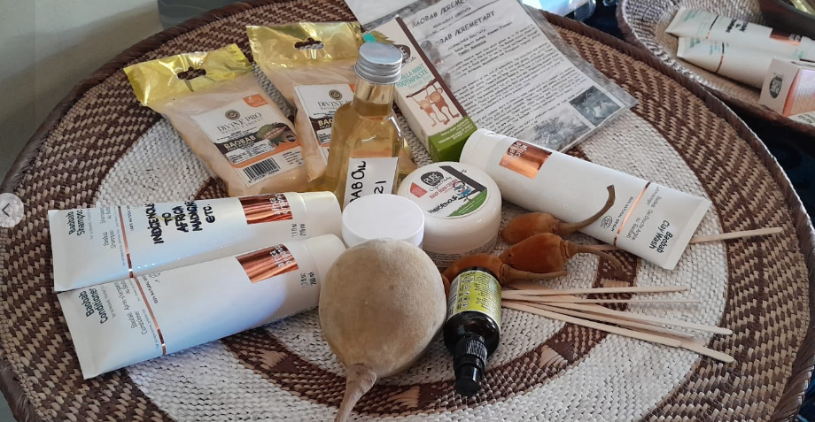
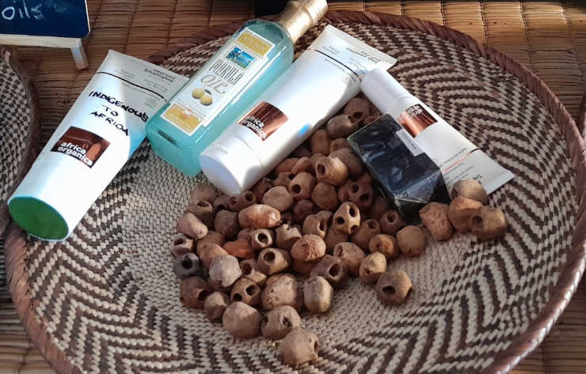
Writing standards with SABS and ISO
A thorough database of the certificates of analysis of producers throughout South Africa was used to compile a range of expected values.
This was then used for the ISO amended standard for the essential oil of Rose geranium and it has now been published by the SABS (South African Bureau of Standards).
For Baobab and Marula a standard was compiled using test results from the producers through producer’s associations.
For Lippia javanica, test results of producers and publications were used and publications of research were included.
The standards are important to distinguish South African oil from that of other countries as well as to indicate it as authentic and not fake.
It also allows negotiation for better prices and internal quality control by the industry.

Slide 7
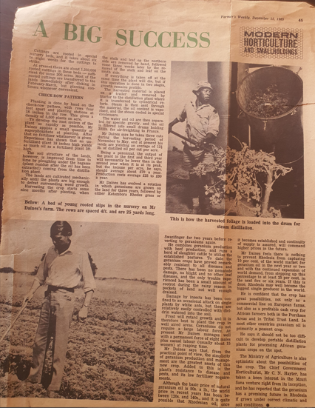
Farmers Weekly DES 1965 Rose Geranium in SA and Zimbabwe as a crop

Slide 8
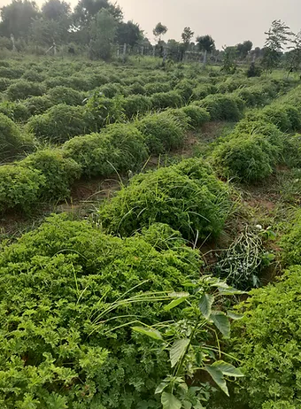
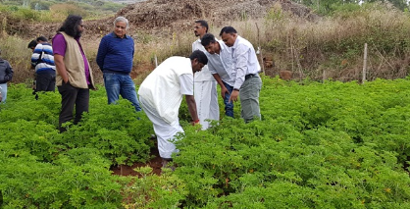
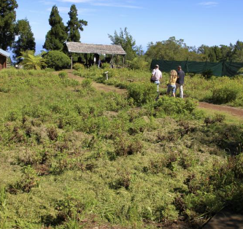
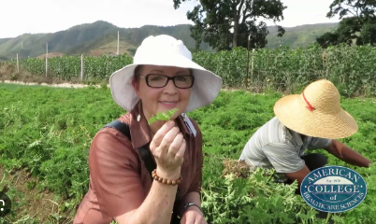
Rose geranium - Rwanda, Egypt, Madagascar, Reunion, China & India – without permits

Slide 9
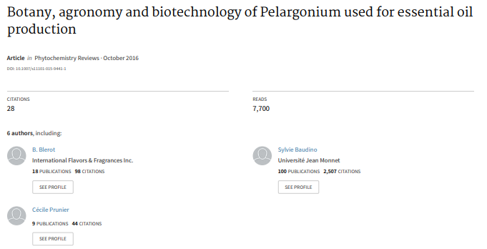
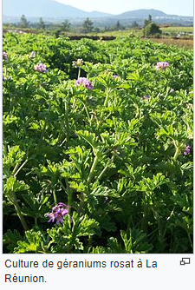
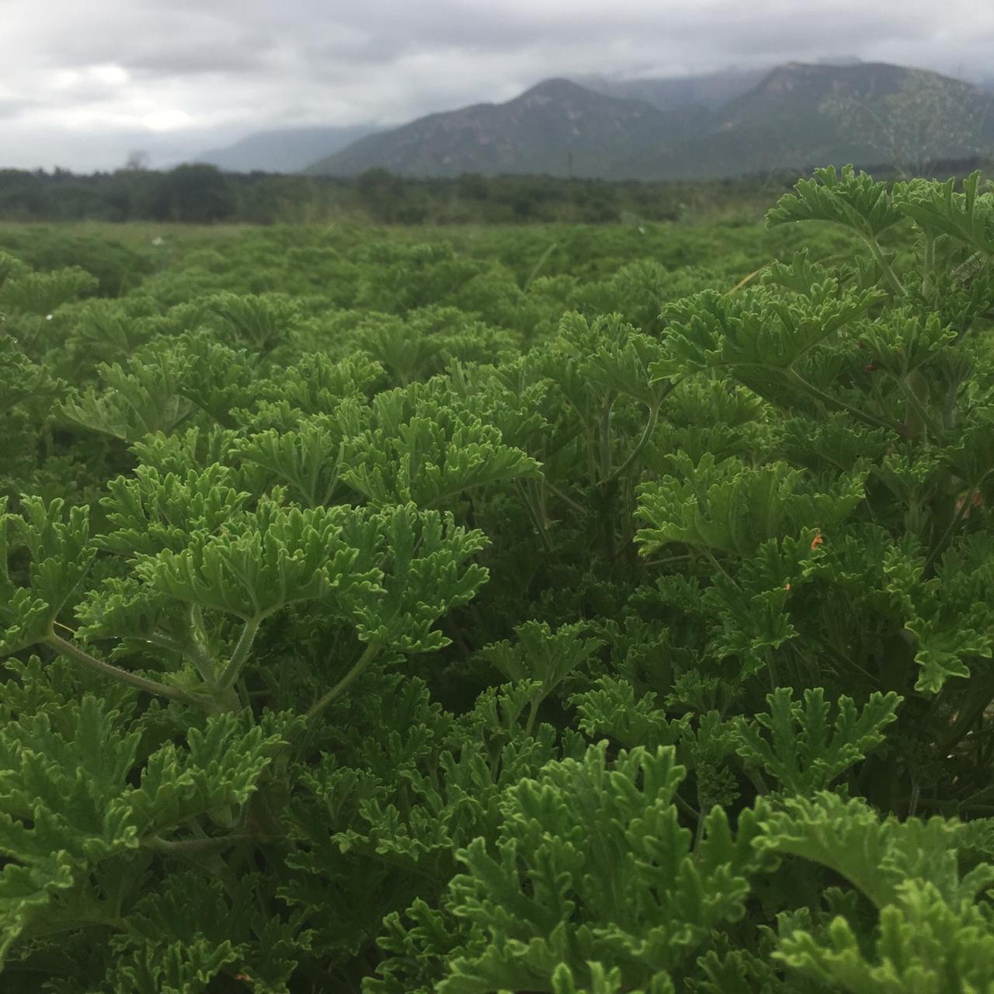
Rose geranium, a misnomer in the trade
SA production
Pelargonium EOs are most often used to replace Rosa damascena EO

Slide 10
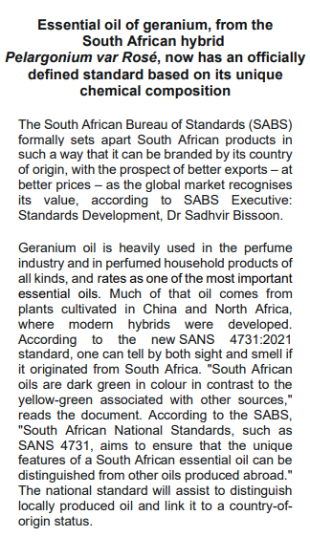
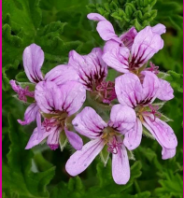
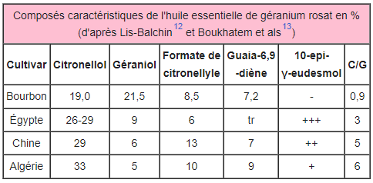
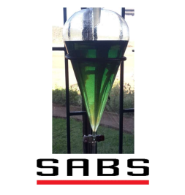
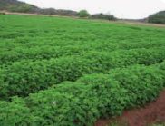
The international misnomer of Geranium oil from Pelargonium graveolens is addressed.
More DNA studies are needed to improve the yield and confirm chemotype of Pelargonium graveolens, P radens and P capitatum in SA.
Pelargonium EOs are most often used to replace Rosa damascena EO, which is very expensive
We are grateful for all the efforts and coordination from the GQSP-SA and UNIDO, Dr Elsie Meintjies, SABS staff, the technical committee and, the oil producers of SAEOPA.

Slide 11
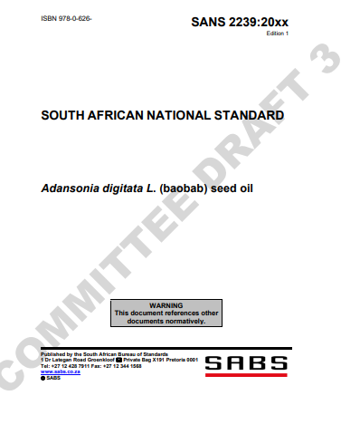
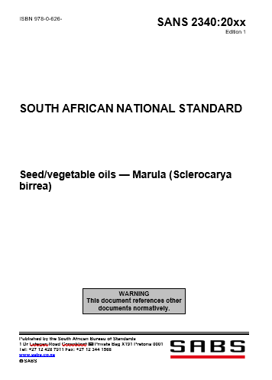
What does a standard look like?

Slide 12
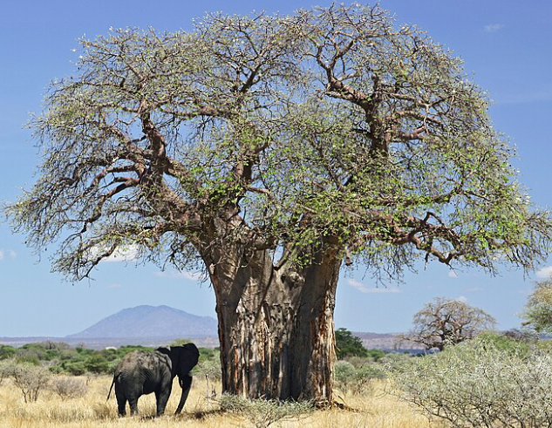
Baobab standard - Published
The Baobab standard for oil has been accepted by the technical committee and included fewer variable as the region for Baobab oil is limited to the northern part of South Africa and its neighbouring countries.
It was found not to be very different across the border in other producing countries.
This has been seen as a tremendous help as the buyers themselves are not always informed of the chemical analysis, and by having a standard, pure oil can be distinguished.
Baobab oil is applied in many cosmetic products as it is assisting in damage repair and health of the skin.
The national standard for baobab oil is now available as a publication.

Slide 13
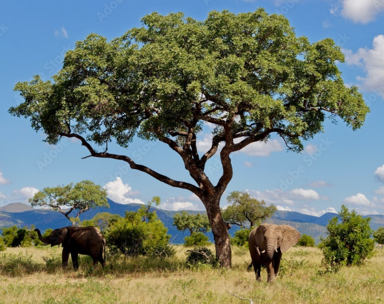
Marula standard second round of public comment
Marula oil has a clear, light-yellow colour and a nutty aroma. It has a saponification value of approximately 188–199 and a specific gravity of 0.91–0.92 (at 15 °C).
Marula oil contains a large proportion of monounsaturated fatty acids which make the oil very stable. The fatty acid composition of marula oil includes:
Monounsaturated fatty acids: Oleic acid (70-80%)
Polyunsaturated fatty acids: Linoleic acid (4-7%) and Alpha-linolenic acid (0.1-0.7%)
Saturated fatty acids of Marula : Palmitic acid (9-12%), Stearic acid (5-8%), and Arachidonic acid (0.3-0.7%)
The Marula oil standard is also submitted by the technical committee and was available for public comment. The draft national standard for marula oil was developed by an expert working group and available for public comment 2nd round.
The standards are important to distinguish South African oil from that of other countries as well as to indicate it as authentic and not fake. It also allows negotiation for better prices and internal quality control by the industry which mostly involves impoverished communities.
Marula oil is used in hair and skin products and becoming increasingly popular as a carrier oil in aromatherapy.

Slide 14
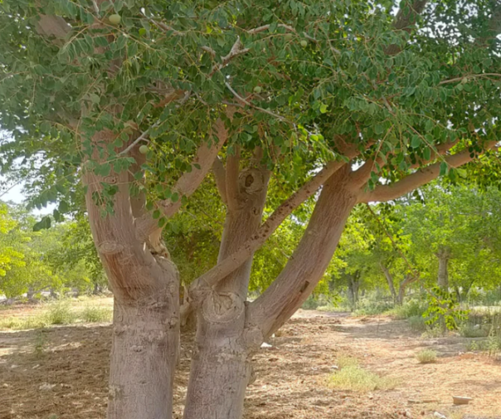
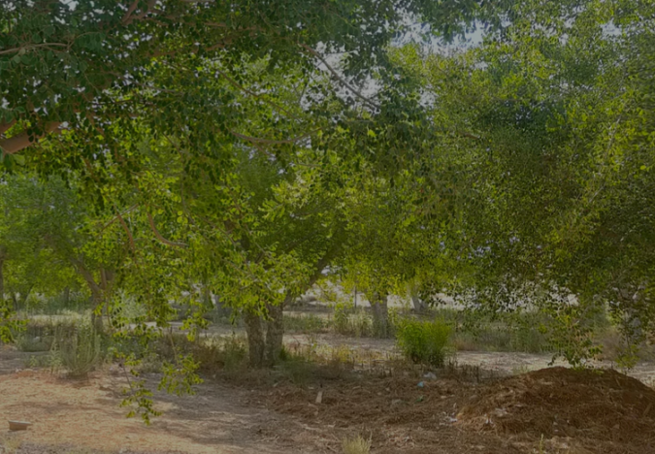
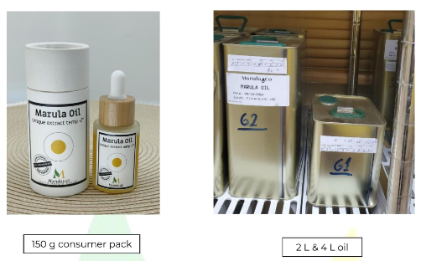
Marula in Israel
Orchard planted
Full fatty acid analysis-
Lauric acid (C12:0): 0.4% - Palmitoleic acid (C16:1, Omega-7): 0.3% - Oleic acid (C18:1n9c, Omega-9): 72.1% - Linoleic acid (C18:2n6c, Omega-6): 4.51% - α-Linoleic acid (C18:3, Omega-3): 0.6% - Behenic acid (22:0): 0.2% - Lignoceric acid (C24:0): 0.2%
https://marulalab.org/
No permits needed

Slide 15
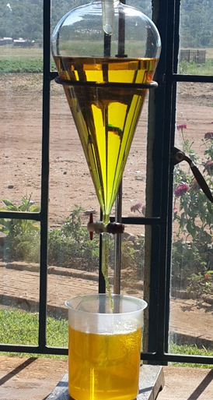
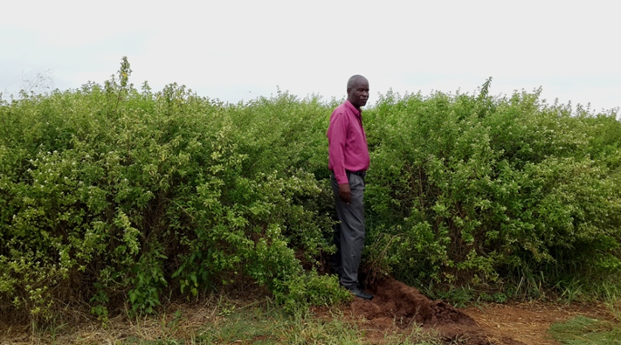
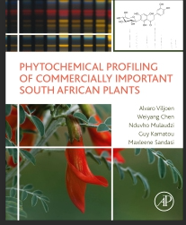
Lippia javanica – next standard by working group and Technical committee formed, first meeting
Drought and flood survivor
Most provinces wild, rural areas
Insect repellent - candles
Tea, gins, and other beverages
Steaming for chest problems
Future for black spot, on export fruit
Permits needed
ACADEMIA
Input MUCH
appreciated!

Slide 16
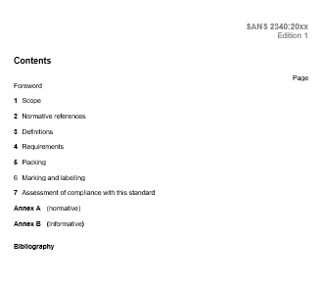
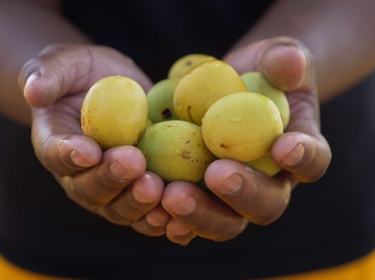
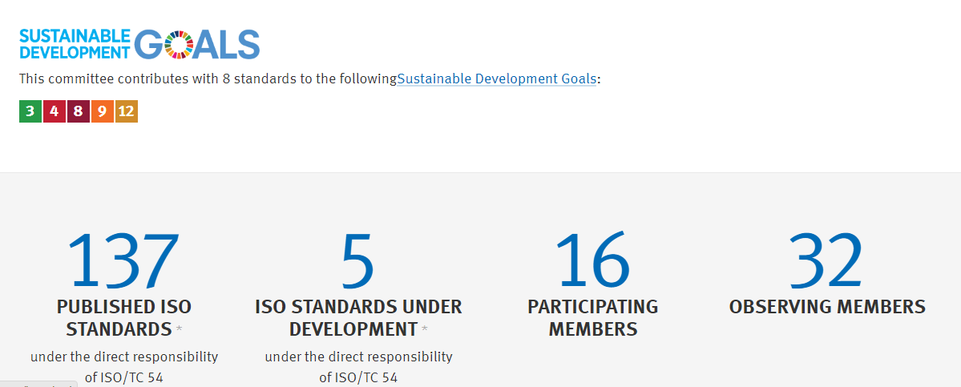
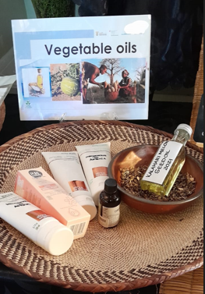
What information is in a standard?
Requirements according to ISO
Appearance
Colour
Odour
Relative density
Refractive index
Acid value
Optical rotation
Miscibility in alcohol
Chromatographic profile
Flashpoint
Packaging, labelling and marketing

Slide 17
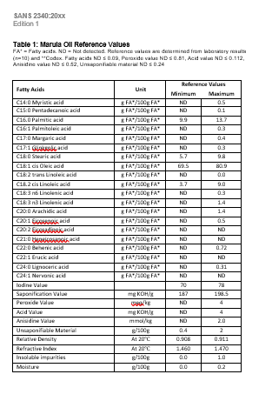
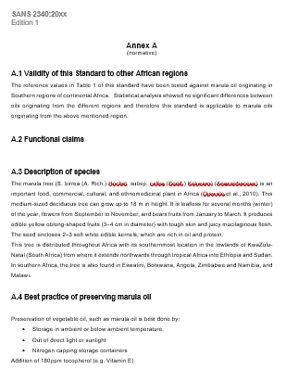
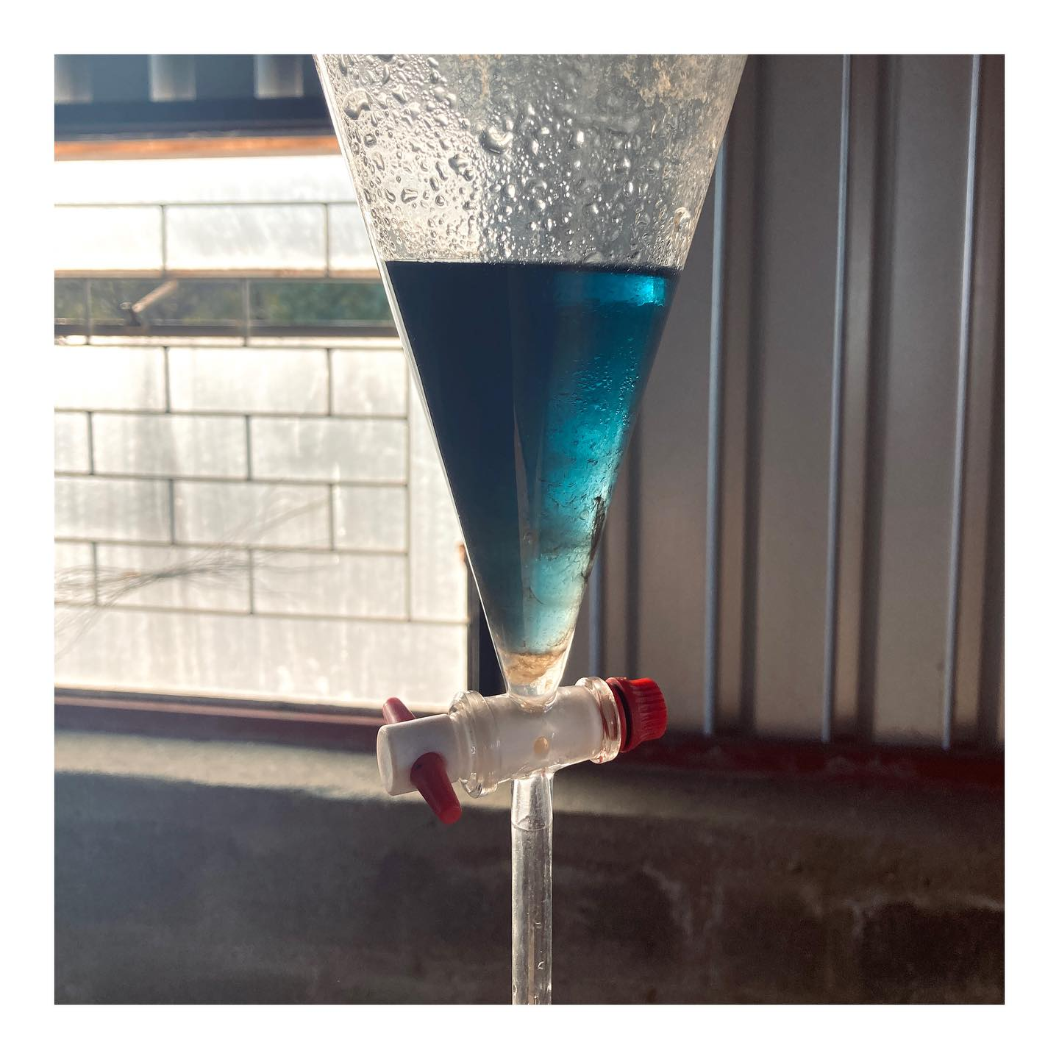
What values are used for the standards?
Colour of the oil included in the standard

Slide 18
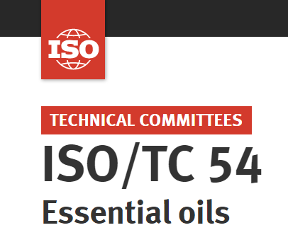
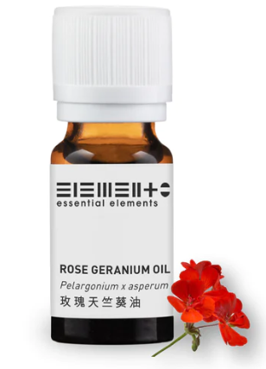
Voluntary standards and certifications
Germany has its own standard. Fair production, a small niche market in terms of certified cosmetic ingredients – Fairtrade, and FairWild (for The ISO 16128 standard covers definitions and criteria for natural and organic cosmetic ingredients and products.
The ISO 9001 standard is the globally recognized and most widely used quality management system standard.
It sets the minimum requirements for a quality management system that companies must comply with to meet the expectations of internal and external stakeholders (such as employees, customers, and government agencies).
The European Federation for Cosmetic Ingredients (EFfCI) has developed a specific Good Manufacturing Practice (GMP) standard for cosmetic ingredients, based on ISO 9001.
In the case of marula oil production, certification of ISO 9001 can be a competitive marketing advantage.
From the Perfumer and Flavourist September 2021 “HPTLC (High-Performance Thin-Layer Chromatography) Fingerprinting for Essential Oil Authenticity” Monika Baeumle, Product Manager TLC, MilliporeSigma
The use of essential oils is showing no signs of slowing down, with an expected growth at a compound annual growth rate (CAGR) of 7.5% from 2020 to 2027 in the global market.
X

Slide 19
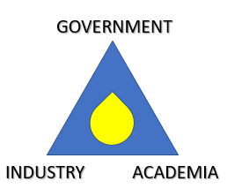
MORE
BETTER
TOGETHER

